Slide 1
2020 sGSL Snow Crab Stock Assessment: A review of recent survey issues
Southern Gulf of St Lawrence
DFO Regional Assessment Process, Feb 2021

Slide 2
Population Indices:
Good measures of abundance or biomass allows for meaningful comparisons of population levels between different regions and/or from one year to the next.
Factors which systematically bias or skew catch observations need to be controlled or accounted for.
Control of identified factors is achieved through the implementation of robust sampling protocols.
DFO Regional Assessment Process, 2020
Notes:
Importance of abundance and biomass indices:
Make sure that everyone understands that indices can be directly equated with abundance and biomass estimates and how reliable they are.
A good sampling protocol aims to control or quantify any factors which may systematically bias observed catches between different survey years or regions.
Examples of controlled factors:
Vessel speed.
Tow duration (5 minutes).
5-minute tow duration
Gear dimensions & configuration.
Time of day
These controlled factors aims to maintain the consistency of trawl behavior between different tows.

Slide 3
Population Indices:
Uncontrolled factors need to be identified, quantified or otherwise accounted for, in order to standardize catches.
Failure to account for influential factors can lead to indices with misleading regional or annual changes, reflecting changes in the factors themselves rather than true changes in population abundance or biomass.
DFO Regional Assessment Process, 2020
Notes:
Examples of factors uncontrolled, but accounted for:
As an example of a quantified factor, trawl width measurements during trawling are made to estimate the total area swept by each trawl of the survey, which shows a lot of variation from tow to tow, through variations in trawl width, touchdown and stop times. This is a quantitative measure of fishing effort and is currently the only factor used to standardize survey catches.
An example of an uncontrolled factor which came about during the assessment last year, was the presence of an extended passive trawling phase at the end of survey tows.
This passive trawling phase, which was unaccounted for, occurs in the gap of time between when the stop signal is given and when trawl finally lifts off the bottom during winching, lasting ~1min20s for 2017 and 2018, but swelled to ~2mins in 2019. Keep in mind that a regular tow is only 5 minutes long, so this addition was a source of concern, potentially representing a significant source of uncontrolled positive bias in our abundance and biomass estimates.
This unaccounted source of trawl swept area came about because a confluence of factors:
The survey vessel showed only a moderate deceleration after the stop signal.
The heading of the survey vessel was largely maintained after the stop signal.
The vessel’s winch was operated at a lower speed than in 2017 and 2018, which extended the period of time the trawl was dragged along the bottom before lifting off.
Swept area for this passive phase estimates seemingly represented a 45% average increase over and above the regular swept area which was previous accounted for (~30-35% for 2017 and 2018).
This led to end-of-tow protocol changes for the 2020 survey:
Stronger deceleration of the survey vessel
Turning or maneuvering of the vessel around the trawl during winching.
Increase of winch speed operation to at least the levels in use during the 2017 and 2018 surveys.
Thus the factor of the passive trawling then became a more controlled factor in the 2020 survey.

Slide 4
Size-frequencies: 2018 versus 2019
Males
Increase of 30-40% over sizes 35-95mm in 2019.
Little change for larger crab (>= 95mm).
Large increases for first 2 visible instars (<25mm).

Slide 5
Size-frequencies: 2018 versus 2019
Females
Same pattern as sub-legal males:
Large increases for first 2 visible instars (<25mm).
Increase ~40% among immature and mature females.

Slide 6
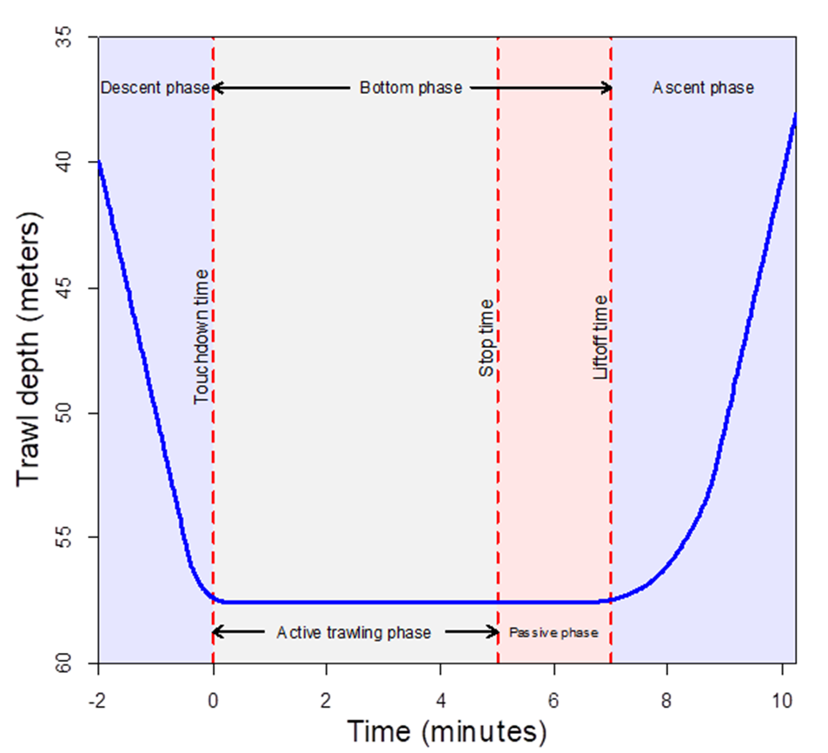
Passive trawling phase update:

Slide 7
Passive trawling phase recap:
Variable | 2017 | 2018 | 2019
Swept area (active phase) | 2815 m² | 2769 m² | 2751 m²
Tow duration (active phase) | 313s | 310s | 307s
Haul time | 218s | - | 254s
Passive phase duration | 82s | 75s | 116s
Passive phase swept area | 1014 m² | 938 m² | 1270 m²
End-of-tow summary:
Slower winch operation in 2019
Vessel continued moving forward.
Moderate vessel deceleration.
Scale of passive phase swept areas suggested as a large source of unaccounted bias.

Slide 8
Protocol changes for 2020:
At the end of tow:
Increase winch speed 2017 and 2018 levels.
Stronger vessel deceleration.
Turn vessel while winching.

Slide 9
Survey vessel speed: end of tow

Slide 10
Survey Vessel Tracks: 2017-2020
Notes:
Longer tracks correspond to tows along the Laurentian channel

Slide 11
2020 Survey Summary:
Variable | 2017 | 2018 | 2019 | 2020
Swept area (active phase) | 2815 m² | 2769 m² | 2751 m² | 2637 m²
Tow duration (active phase) | 313s | 310s | 307s | 301s
Haul time | 218s | - | 254s | 216s
Passive phase duration | 82s | 75s | 116s | 130s
Passive phase swept area | 1014 m² | 938 m² | 1270 m² | -
These results for 2020 are counterintuitive:
Haul times are short – therefore winch is faster.
…but passive phase duration has increased to 130s.

Slide 12
Passive phase duration increase:
Upward force acting on the trawl doors is a function of:
Tension of the warp cables acting on the doors.
Steepness of the angle between the cables and the bottom.
While the contribution of the winch to the cable tension has increased in 2020, the amount of force exerted by the survey vessel has decreased.
The trawl and the vessel must be closer together before lifting off, i.e. the angle must be steeper.

Slide 13
Size-frequencies in 2020:
Males
Catches in 2020 are very comparable to 2019, i.e. no scale reduction associated with the modification of end-of-tow procedures.
Large increase in instar VII crab in 2020.
Size-distribution among legal-sized crab is very similar between the 2018, 2019 and 2020.

Slide 14
Size-frequencies in 2020:
Females
As for males, female catches for 2020 are very comparable to 2019
Large increase in instar VII crab in 2020.

Slide 15
How does the 2019 comparative fishing experiment fit into the catchability discussion?
Question:

Slide 16
2019 Comparative fishing experiment:
Experiment:
Side-by-side fishing.
Final 40 stations of the survey.
Area west of Cape Breton.
Results:
Analysis showed that catches for male and immature females were comparable between the two vessels.
Catches of mature females were larger in the older vessel.
This contradicts the 2018-2019 trend in the remainder of the survey… so what’s going on?

Slide 17
Local Changes in Survey Catch of 2019 versus 2018:
Ratio of the number of sub-legal males larger than 35mm CW caught in 2019 versus 2018 snow crab surveys. Increases are red, decreases are blue, and white indicates no change. Survey grids containing less than 10 crab were shrunk as a function of sample size.

Slide 18
Local Changes in Survey Catch of 2019 versus 2018:
Ratio of the number of mature females caught in 2019 versus 2018 snow crab surveys. Increases are red, decreases are blue, and white indicates no change. Survey grids containing less than 10 crab were shrunk as a function of sample size.

Slide 19
Local Changes in Survey Catch of 2019 versus 2018:
Ratio of the number of legal-sized males larger than 35mm CW caught in 2019 versus 2018 snow crab surveys. Increases are red, decreases are blue, and white indicates no change. Survey grids containing less than 10 crab were shrunk as a function of sample size.

Slide 20
2019 Comparative fishing experiment:
Catch increases in sub-legal males and mature females are widespread throughout the sGSL, but are more concentrated in certain areas.
The pattern for legal-sized males is much more varied.
The comparative fishing stations were not located in areas where large catch increases were observed.
Increases in catchability may vary by bottom type.

Slide 21
Why has the legal-sized male abundance remained so stable between 2018-2020, given the seeming increase in catchability among sub-legals and females?
Question:

Slide 22
Discussion:
There are two hypotheses regarding legal-sized male abundance not following the sub-legal increase in 2019:
Catchability increase is present among sub-legal crab sizes only.
… but why would there be a 30-40% contrast in the relative catchability between 80-90mm crab and their legal-sized counterparts?
Significant increase in mortality among legal-sized males in 2019 and 2020, relative to 2018.
There have been large-scale spatial redistributions of fleet fishing effort.
This was accompanied by significant increases in fishing effort, in part due to lack of access to prime fishing grounds, which may have led to significant increases in discard mortality.

Slide 23
Conclusions:
It is likely that the swept area and efficiency of the trawl during the passive phase has significantly decreased with the introduction of the new protocol measures in 2020 .
However, 2019 and 2020 size-distributions were strikingly similar, except for a large recruitment increase of instar VII (~30mm).
Consequently, passive-phase trawling does not seem to be the cause behind the 30-40% increase observed in sub-legal crab from 2018 to 2019.
While the underlying mechanism remains unknown, its scale seems to be similar in 2019 and 2020, pointing to some sort of vessel effect .
Removal of passive phase trawling as a likely source of bias entails that abundance and biomass estimates for 2019 and 2020 were likely not overestimated, though it follows that some estimates of 2018 (i.e. sub-legal crab) were likely underestimated.
The lack of dynamics among legal-sized males from 2018 to 2020 is perplexing. Explaining this apparent stability requires resolution between the competing hypotheses of constant catchability or that of a strong increase in mortality from 2018 to 2019 and 2020.

Slide 24
Conclusions:
The survey time series is inconsistent, at least for sub-legal males and mature females, at the juncture of the vessel change in 2019.
Predicted recruitment levels for 2020 and 2021 are likely to be inflated, and risk curves are likely underestimate the stated exceedance probabilities.

